Slide 1

Navigating preclinical confirmatory multicenter trials
Natascha Drude, Clarissa França Dias Carneiro, Meggie Danziger, Anja Collazo, Silke Kniffert, Ulrich Dirnagl, Ulf Tölch

Slide 2
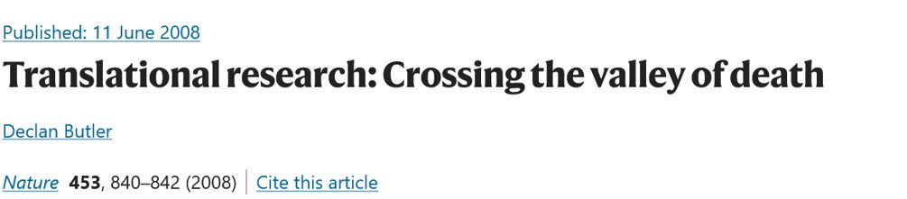
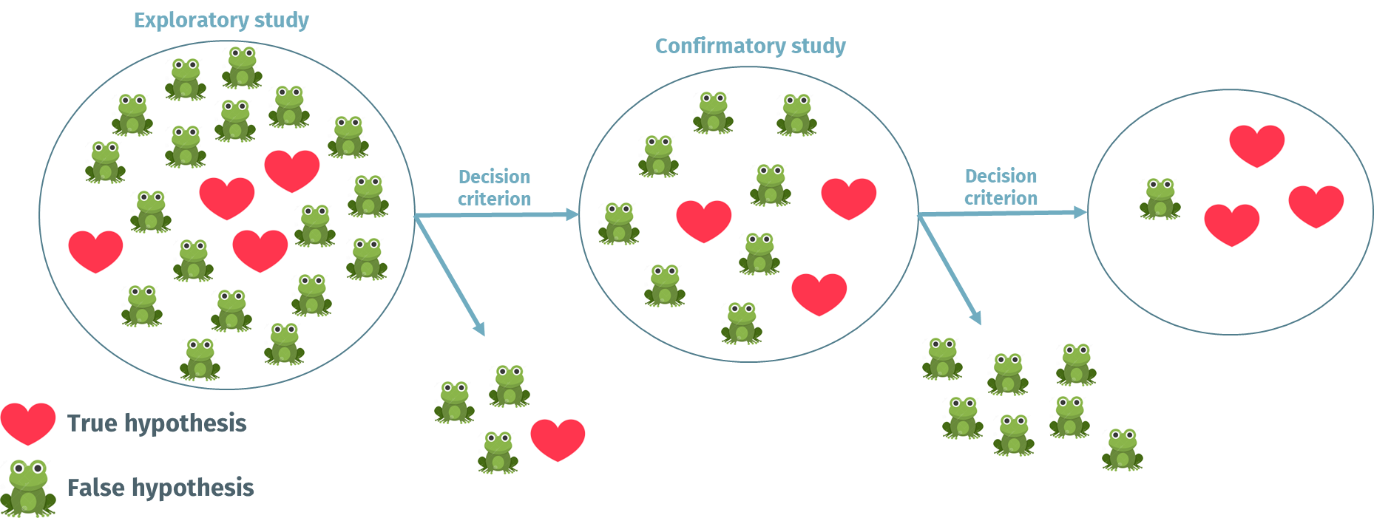
Reproducibility and the challenge of translation
Confirmatory study
weed out false positives
Notes:
Evidence generated in preclinical efficacy studies is often weak. Low numbers of animals, selective reporting, publication bias and consequently inflated effect sizes threaten translation into clinical contexts and threaten research integrity. To strengthen preclinical evidence, confirmatory studies are proposed as a powerful tool to weed out false positives, gain a deeper understanding about mechanisms, and refine the experimental design based on the exploration by increasing internal, external, and translational validity.

Slide 3

2018/19 pioneering BMBF Call:
Confirmatory Preclinical Studies and Systematic Reviews
https://www.gesundheitsforschung-bmbf.de/de/8344.php
“The aim of this funding measure is to strengthen preclinical research and its transfer of results.”
“These confirmatory studies are intended to validate the findings of exploratory studies.”
Funding: 12 confirmatory studies
Multicenter approach
Preregistration mandatory
All had statistical advice
DECIDE = Accompanying project

Slide 4
What have we learnt so far?
Confirmation when and how…
https://www.bihealth.org/fileadmin/QUEST/Publikationen/Bericht/DECIDE_Guidance_for_planning_and_conducting_confirmatory_preclinical_studies_and_systematic_reviews.pdf

Slide 5
Minimum requirements before starting a confirmatory study
Blinding on the level of outcome assessment
Experimental units were randomized
Transparency about animal attrition and/or outlier removal
Clear definition of primary outcome
Basic quality management procedures
Model is disease relevant, and limitations are acknowledged
Notes:
If uncertainty is still high, optimization of evidence via replication studies to (i) increase sample size, (ii) improve internal validity, (iii) introduce systematic heterogenization and/or (iv) flanking experiments

Slide 6
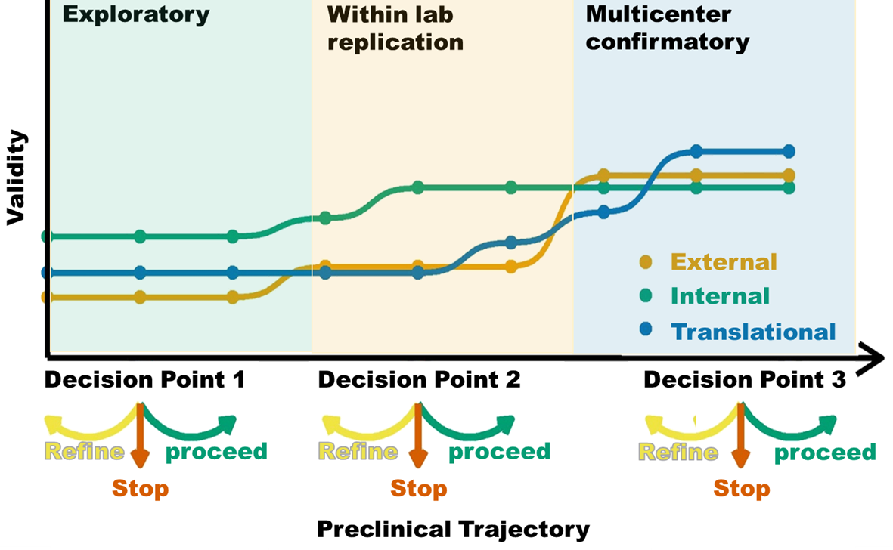
Generated evidence should be strengthened along the preclinical research trajectory
Drude et al., eLife 2021;10:e62101 doi: 10.7554/eLife.62101
Notes:
If uncertainty is still high, optimization of evidence via replication studies to (i) increase sample size, (ii) improve internal validity, (iii) introduce systematic heterogenization and/or (iv) flanking experiments

Slide 7
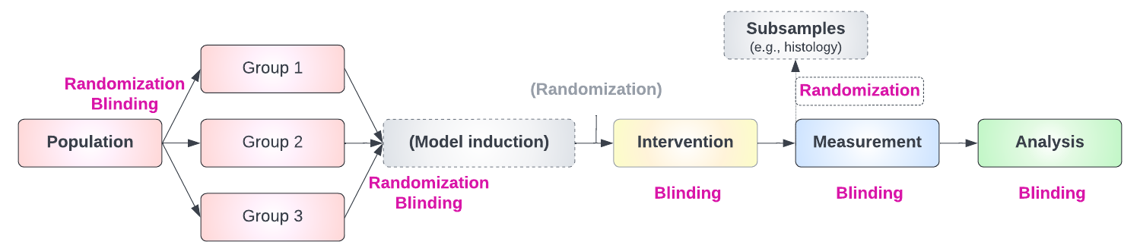
Apply strategies to reduce bias
Procedures for randomization and blinding should be stated for all stages
Outcome relevant physiological parameters should be considered → block Randomization
Method/tool should be stated https://www.randomizer.org/
Experimental Design for Laboratory Biologists by Stanley Lazic, 2016 https://doi.org/10.1017/9781139696647
Notes:
No dichotomy

Slide 8
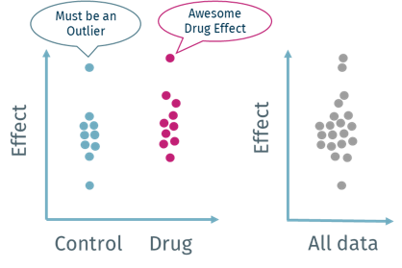
Reduce risk of bias to a minimum –Preregistration
A priori definition of:
    Inclusion/exclusion criteria
      animal welfare considerations, animal model and data
      outliers should be defined across all groups and not only for a specific treatment group
    Primary outcome measure(s) (used for sample size calculation)
    Statistics
    Experimental unit
Experimental Design for Laboratory Biologists by Stanley Lazic, 2016 https://doi.org/10.1017/9781139696647

Slide 9
Quality control/ assurance
Assure the quality of
    medicinal product(s)
    cells
    animal model
    Phenotypes/ genotypes
Consider strategies for harmonization and trainings between different labs
Consider audits as a communication tool
Notes:
Report full datasets and report all excluded animals with reason

Slide 10
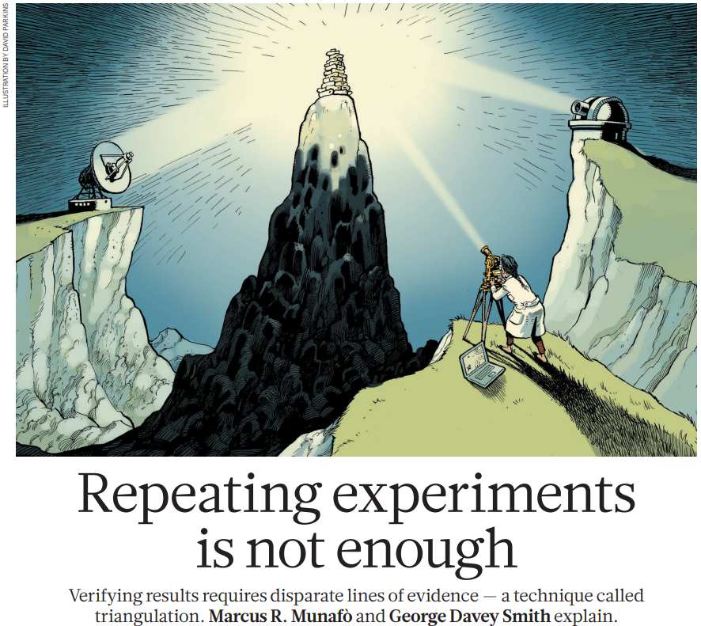
Confirmatory studies do not need to be exact replications
Primary outcome, essential methods, and model should stay constant between exploratory and confirmatory phase
Any deviations should be motivated and strengthen validity
Triangulation –converging evidence
Nature 553, 399-401 (2018)
Notes:
Motivated e.g., by evidence from explaration, or increase in external validity 8by including additional strains or refineing the animal model

Slide 11
Systematic heterogenization – external validity
Gene – environment interactions
Environmental differences between centers
Limited number of systematic heterogenization factors between centers
Balance between strengthening external validity and comparability of centers
Use of both sexes
https://www.ukri.org/news/use-of-both-sexes-to-be-default-in-laboratory-experimental-design/
Notes:
Motivated e.g., by evidence from explaration, or increase in external validity 8by including additional strains or refineing the animal model

Slide 12
Control groups and animal model –translational validity
If applicable include
positive and negative controls
comparator from standard clinical care
Model (limitations)
to what extent does the model mimic the human situation?
consider (clinical) biomarkers and/or diagnostics like imaging

Slide 13
Statistical analysis and Study Planning
Consult a (bio-)statistician in the planning phase
Sample size calculation must be based on experimental unit
Do not use the exploratory effect size ⇨ instead: smallest effect size of interest or shrinkage factor
Sample size estimation needs to account for larger biological variability (heterogenization)
Blocking or stratification factor used for randomization should be incorporated as a covariate
Notes:
Larger sample sizes with higher power to detect effects that are smaller than the exploratory ES –increase reliability
SESOI can be clinical relevant, biological relevant (depends on research question)
Use of a particular SESOI or shrinkage factor may be based on different considerations (e.g., previous evidence, practical constraints/feasibility). Those considerations should be transparently reported

Slide 14
Multicenter considerations
What kind of results need to be replicated across centers ?
Number of external labs should be limited (≤ 3)
External labs should be experienced in the models/methods
(External) labs can perform complementary measures to generate supporting evidence
Pre-define center-allocation scheme in randomization process
      prioritize covariates
Notes:
Core results are outcomes that reflect your main effect and ideally are gold standard measures for your paradigm (some examples: Stroke: lesion volume; Cancer: cancer volume across time and survival; Cardio: left ventricular ejection fraction measured via gold standard method)

Slide 15
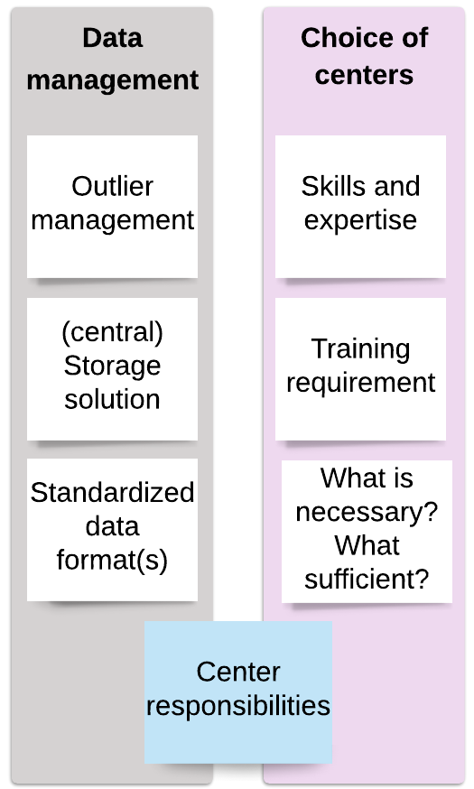
Multicenter considerations
Harmonization of processes like protocols, but also animal permit application need time and resources
Compare controls/ baseline of primary outcomes across centers
Protocols and data format, storage and analysis should be harmonized
Notes:
Core results are outcomes that reflect your main effect and ideally are gold standard measures for your paradigm (some examples: Stroke: lesion volume; Cancer: cancer volume across time and survival; Cardio: left ventricular ejection fraction measured via gold standard method)

Slide 16

Special considerations for in vitro and ex vivo models
Meta-data of donors (age, gender, disease relevant information) ⇨ source of variance
Make sure structure of statistical models reflect hierarchical structure and biological units/observational units properly
Inclusion criteria for donors

Slide 17
Take home – think clinical translation
Check minimum validity and reliability criteria before confirmation
(Animal) Model should be disease relevant and limitations be acknowledged
Biomarkers, diagnostics and competitors from standard clinical care should be considered whenever possible
Sample size calculation based on smallest effect (size) of interest or a shrinkage of the effect size from exploratory studies
Consider sources of variation (systematic heterogenization)
Consider experience, responsibilities, harmonization processes and added value of partner labs

Slide 18

Thank you!
  Please do not hesitate to contact us:
  decide@charite.de
  QUEST Center for Responsible Research
QUEST Toolbox

